Slide 1
The Use of Colour in Teaching & Learning
Research Question
“How can colour be used in teaching materials, both digital and analogue, to improve student lived experience, attention and attainment?”
Julia Redman, Lecturer & Unit Leader BSc Fashion Management
PGCert 25/26

Slide 2
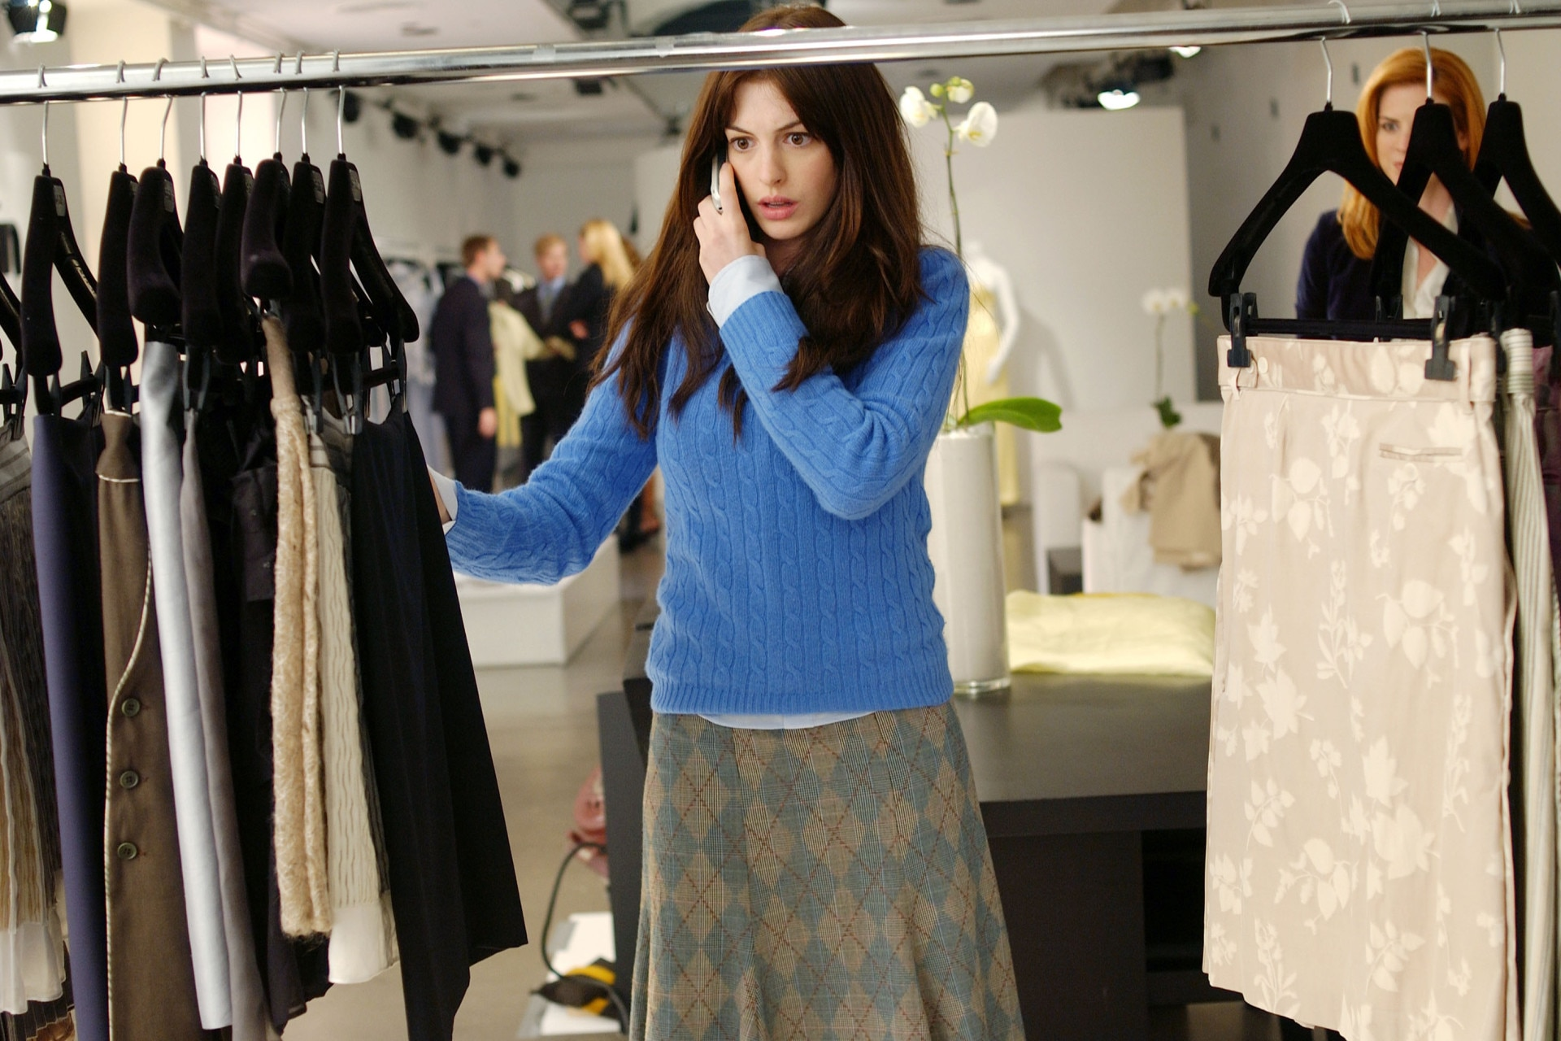
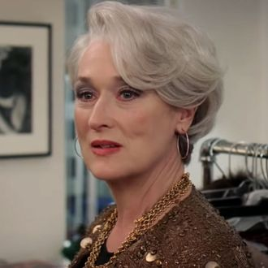
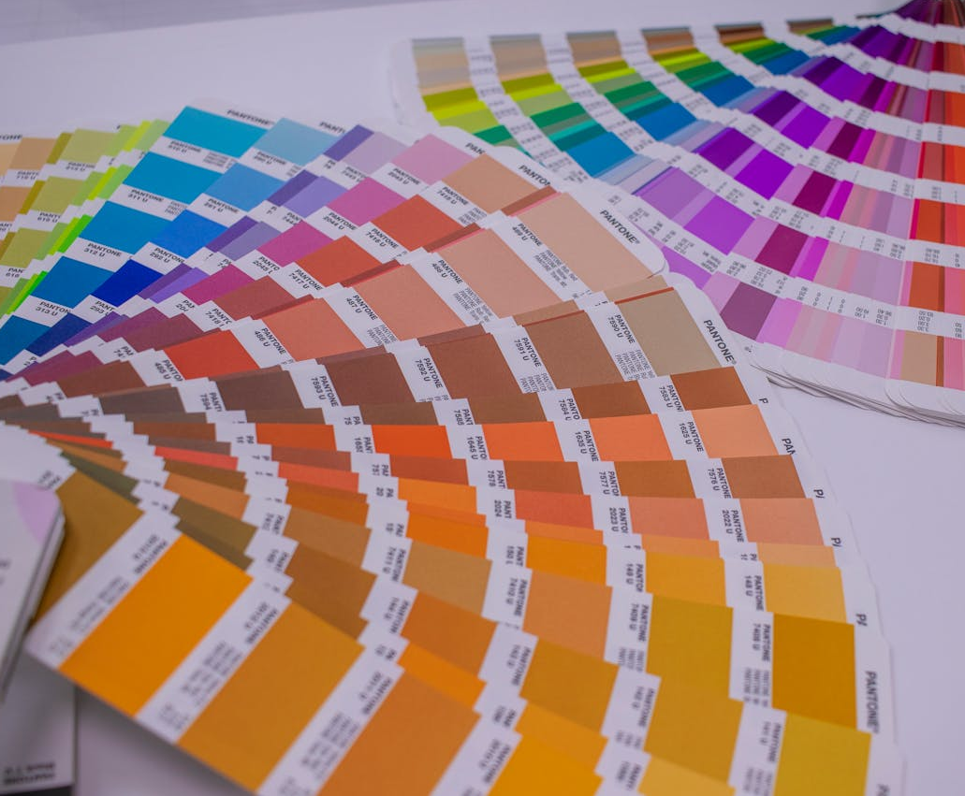
Context & Background
Colour is inherently important in the creative fashion industry in which we operate!
Within the FBS, we have a very professional looking, black on white template for lecture and seminar production which states “Colours should be used sparingly. Use no more than two colours per presentation”.
This research project will explore the impact of colour in visual content on student wellbeing and their learning experience.

Slide 3
Rationale
With the increasing number of students (17-18%) exhibiting disabilities and/or neurodiversity at UAL (E,D & I Report, 24/25) I was interested to understand more about the way we present our content in lectures and seminars, and how well it serves the needs of those students, and the wider cohort, at the Fashion Business School, in the context of my own professional practice.
Colour is emotive, it can guide attention and evoke emotions such as trust, calmness, optimism, creativity and enthusiasm, all of which has the potential to improve concentration & reduce anxiety, leading to higher levels of attainment (Meliksetyan, 2025).
“Colour is a power which directly influences the soul”
Wassily Kandinsky, Artist

Slide 4


ACTION RESEARCH PROCESS
1. Identify
4. Analyse
Explore the impact of colour in visual content on student wellbeing and their learning experience.
Understand how colour in visual content can affect mood, concentration and retention.
Inherently individual nature of colour preferences and impacts.
Impact of colour on concentration, attention, retention.
Varible perception & absorption of information.
2. Plan
Research Question
5. Reflect
Secondary research - Arnold Wills, Irlen Syndrome, Elliot & Maier, Meliksetyan, Kurnaz, Meric, Pursun, Jutlay, NDS, Universal Design.
Primary research - qualitative & quantitative.
Sensory processing issues are likely to be more widespread than realised.
Further, more in depth research & building of relationships with experts required.
“How can colour be used in teaching materials, both digital and analogue, to improve student lived experience, attention and attainment?”
3. Act
6. Conclude
Primary data collection via surveys & interviews.
Take Irlen Syndrome Test
Explore need for sensory & cognitive equity in teaching and learning.
Colour & lighting environment have a powerful impact on potential learning experience.
Choice, adaptability, self correction, external experts & providers will help enhance student experience.
Physiological & Sensory Impact
Psychological and Emotional Regulation
Design & Content Structure
Demographic & Disability Specifics

Slide 5
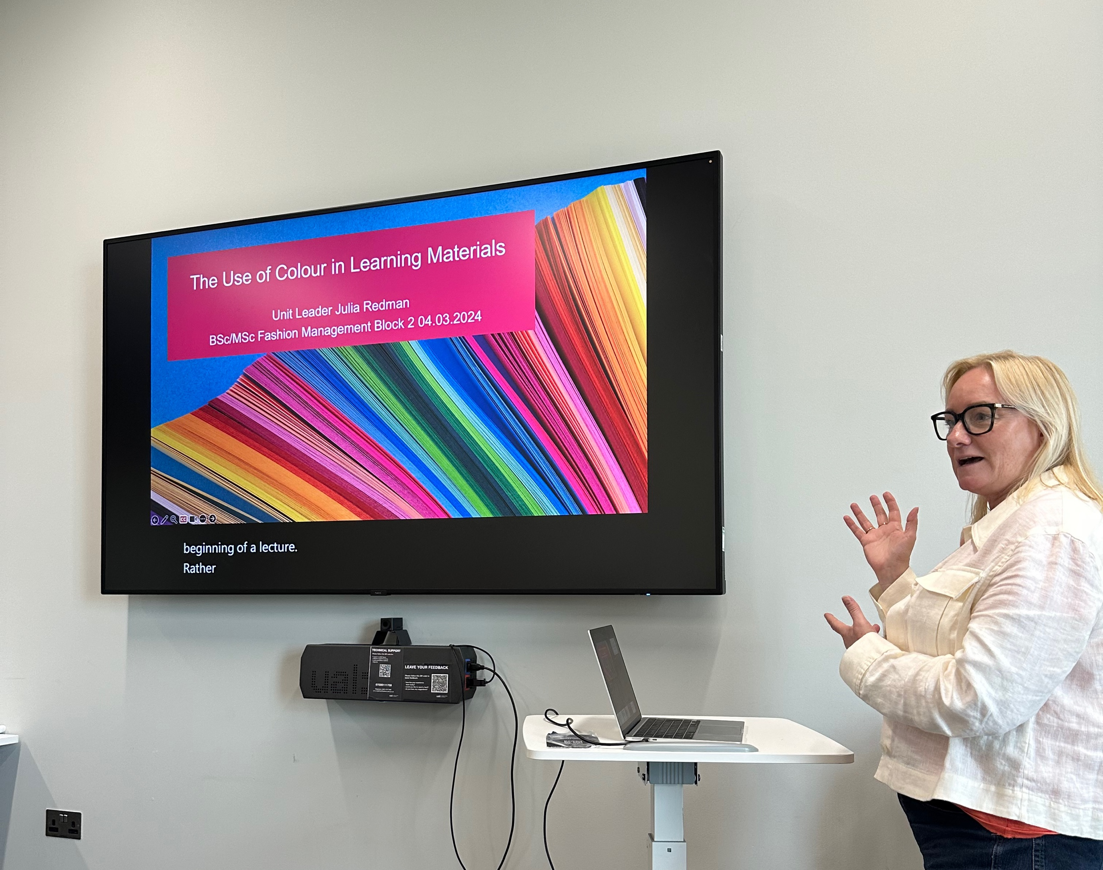
Social Justice Angle
"Around one in five people are neurodivergent" (Neurodiversityhub, 2025)
The social justice issue addressed by this research is the need for cognitive and sensory equity within higher education.
Challenges the "one-size-fits-all" approach, arguing that standardised design practices, specifically the use of stark black text on white backgrounds, act as a systemic barrier to the academic success and physical well-being of a wide variety of both neurodiverse and neurotypical students.

Slide 6

Secondary Research
According to Arnold J Wilkins (Reading Through Colour, 2003), the use of “coloured overlays on text can improve reading....and has been shown to reduce fatigue and increase fluency”.
Further investigation has shown how the use of colour in teaching materials improves concentration, engagement and retention of information (Jutlay, 2023).

Slide 7
Secondary Research
An article in the International Journal of Progressive Education (Kurnaz, Meric, Pursun, 2022), stated that whilst “some colours have a stimulating effect on individuals, some others have a calming effect”.
Some colours might create a more relaxed environment, whilst others induce anxiety, dependant on culture, age, gender, the studied topic and activity.
The vibrational stimulation of different colours will affect the physical, emotional and mental reactions of individual students in a variety of ways, contributing to their ability to concentrate and retain information (Kurnaz, Meric, Pursun, 2022).

Slide 8
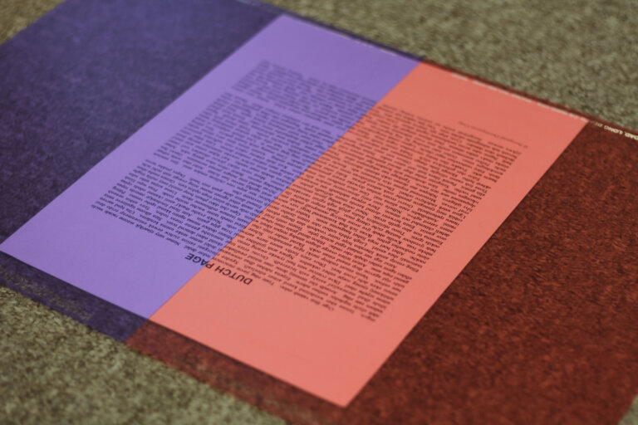
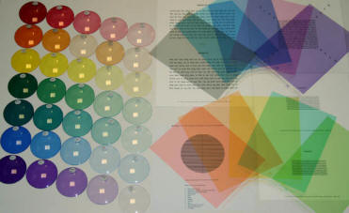
Secondary Research
The Neurodiversity Design System, which combines neurodiversity and user experience design for Learning Management Systems states that “cognitive fatigue can be increased by high contrast (black text on white background)”.
“Learners with an oversensitive visual cortex, visual-perceptual disorder, and learners with dyslexia related difficulties will experience processing issues identified as part of their neurotype” (Irlen, 2025)

Slide 9
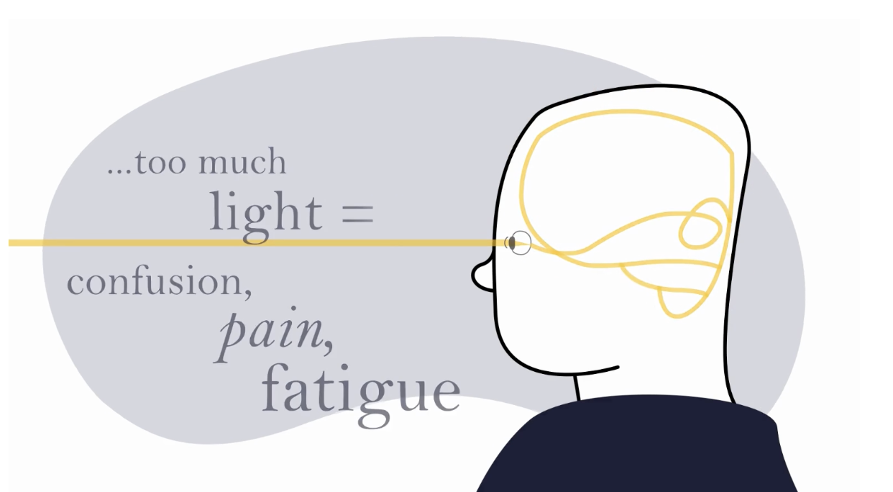
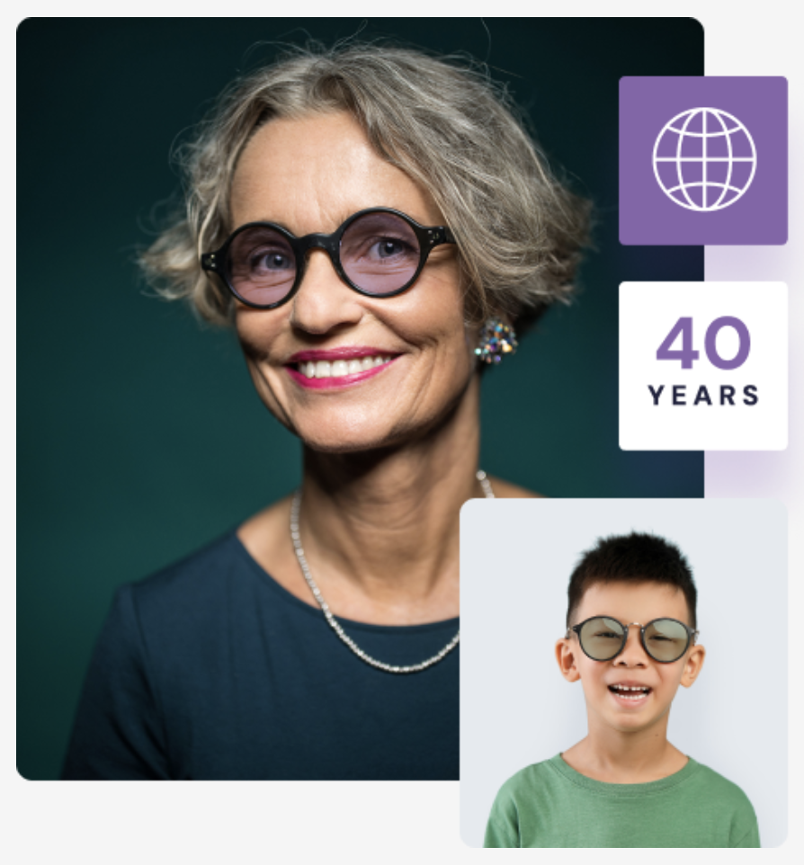
Secondary Research
Irlen Syndrome is a light-based visual processing problem which can result in a multitude of visual, physical, cognitive, emotional and neurological symptoms (Irlen, 2025).
According to Helen Irlen, visual stress can be greatly reduced with the addition of colour, in both visual learning materials, and/or with the use of coloured spectral filters in the form of tinted overlays or glasses.
NB. Irlen Syndrome affects 12-14% of the general population, 46% of those with reading & learning difficulty, 33% with ADHD, 33% with autism, 55% with head injury/whiplash etc.

Slide 10
Reflection on Research
Individuality of response to colours, shades, luminosity & intensity. Colour in Context Theory emphasises importance of situational analysis (see Appendix 10) vs prescriptive rules in UI design (Elliot & Maier, 2012).
Qualitative data provided some in depth insights into individual needs & preferences, whilst more in depth quantitative study was required to drive out broader conclusions.
Identified a clear need for ongoing pedagogical research into colour theory and it’s physiological, psychological and emotional impact on student behaviour, concentration and attention.
Discussion with interviewees (students & staff) indicates that the longer the lecture/seminar, the greater the propensity for eye strain and cognitive fatigue, compounded by black on white content.
Limitations of the research are borne out in the relatively low number of survey respondents/interviews, and the restrictions of time for further reading and comprehension.
“People will forget what you said. People will forget what you did. But people will never forget how you made them feel.” Maya Angelou

Slide 11
KEY THEMES & PROJECT FINDINGS
Physiological & Sensory Impact
Psychological & Emotional Regulation
Design & Content Structure
Demographic & Disability Specifics
Visual Processing Barriers:
High contrast black on white may be “painful” causing potential “eye strain”
Offensive light waves causing inability to process, leading to Irlen Syndrome symptoms.
Luminosity - bright yellows and purples with perceived fluorescent undertones inhibit reading.
Emotional State & Energy
Calming/soothing - soft blue & green potential to relax nervous system and reduce stress.
Vibrancy & Joy - yellow & red linked to “happiness” & “joy” but may overstimulate for some.
Boredom factor - black on white perceived as “emotionless” & “dull”, leading to loss of focus.
Visual Literacy vs Text Density
Graphical Journeys - preference for infographics, timelines & pillars of information over dense “wordy” text.
Image functionality - irritation caused by irrelevant, space filler imagery: requirement for “relevant”, “tangible” imagery.
Neurotype Specific Preferences
Autism - sensitivity to intense sensory or visual stimulation, highly individual preferences, often green or red.
Irlen Syndrome - sensory processing difficulty, highly individualised colour preferences.
Dyslexia/Learning Disabilities - strong preference for calming/cool tones such as blue and green.
Mitigation & Comfort:
Softening - use of blue, cream or grey backgrounds to promote “approachable” and “calmer” visual environments.
Self-correction tools - students using “night shift” or reduced brightness on laptop screens.
Dark Mode Transition - white text on black or dark blue as a “summary” or to prepare eyes for a “transition”.
Focus & Academic Anxiety
Concentration support - cool colours promote “harmony” and help some students retain focus.
Anxiety reduction - appropriate colour choices may result in “reduced levels of anxiety” and prevent “academic exhaustion”.
Design Strategy
Use of colour to “draw the eyes across a slide” or highlight “keywords”.
Visual structure - breaking content into interlinking pop-ups, diagrams and visuals to maintain engagement.
Development & Gender Variables
Educational Level - preference for bright colours in primary years to cool & darker tones in secondary and higher education.
Gender trends - similarities in preferred colour choices, although individual preferences do not necessarily appear connected to gender.

Slide 12
Conclusion & Recommendations
Colour preferences and their effects vary widely from one individual to another, suggesting the need prioritise choice & adaptability in teaching & learning materials.
Effective use of colour and easing of complexity can significantly enhance focus and emotional stability in neurodivergent students, improving concentration & attention.
Colour, light and visual intensity of the teaching materials and environment will all contribute to the perception of information & the individual student experience for all.
Adjust default template to black type on a soft blue background to create trust and a calming effect on the student environment.
Add dimmer switches to classrooms to facilitate a softer lighting environment. Build screen breaks and practical activities into lectures to reduce eye strain & cognitive fatigue.
Advise students (& staff) of self correction tools to reduce screen brightness, or switch to night shift mode to reduce eye strain and improve concentration, take the online test for Irlen Syndrome, follow up with free consultation if needed.
Build external relationships & collaboration eg. Irlen Institute to develop further understanding of how we can use colour most effectively to improve the student experience.

Slide 13
References
Elliot, J & Maier, M, Colour Psychology: Effects of Perceiving Colour on Psychological Functioning in Humans. Available at: https://www.researchgate.net/publication/279871278_Color-in-Context_Theory (Accessed Jan 2026)
Irlen, H. The Irlen Method https://irlen.com/the-irlen-method/ (Accessed Nov. 2025)
Jutlay, Parmi (2023). Colourful Classrooms: Unlocking the Power of Colour in Learning. Available at: https://www.ecoprinters.net/en/eco-blog/colourful-classrooms-unlocking-the-power-of-colour-in-learning (Accessed Jan. 2026)
Kurnaz, A., Meric, A., Pursun, T., An Investigation of Colour Preferences of Students with Special Needs, (2022). Available at: https://files.eric.ed.gov/fulltext/EJ1363978.pdf (Accessed Dec. 2025)
Meliksetyan, G, The Psychological Meaning of Colour in Design: A Semantic Review (2025). Available at: https://www.researchgate.net/publication/391197119_THE_PSYCHOLOGICAL_MEANING_OF_COLOR_IN_DESIGN_A_SEMANTIC_REVIEW (Accessed Jan. 2026)
Neurodiversity Design System, Colour (November 2023). Available at: https://neurodiversity.design/principles/colour/#:~:text=The%20choice%20of%20colour%20for,preferred%20for%20main%2F%20body%20text. (Accessed Oct. 2025)
Neuro Diversity Hub. Available at: https://www.neurodiversityhub.org/ (Accessed Nov. 2025)
The 7 Principles of Universal Design. Available at: https://universaldesign.ie/about-universal-design/the-7-principles (accessed Jan. 2026)
Wilkins, Arnold. J., Reading Through Colour: How coloured filters can reduce reading difficulty, eye strain and headaches (2003)

