Slide 1
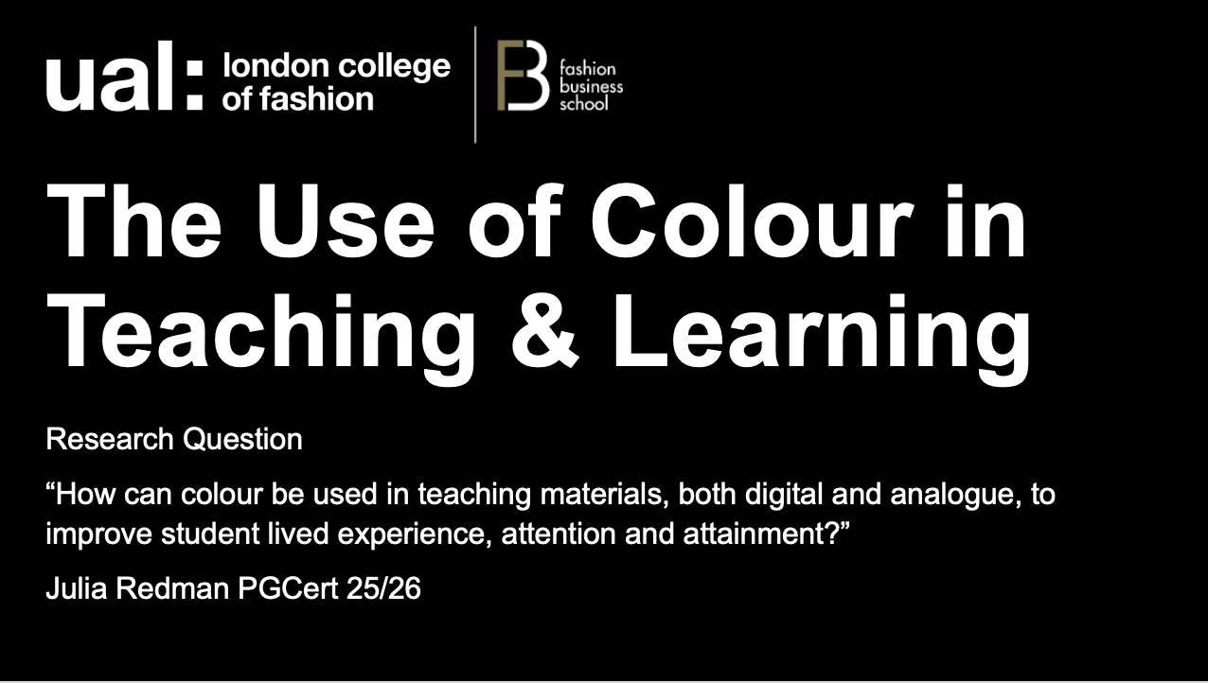
Notes:
How do you feel about this slide as an introduction to a lecture?

Slide 2


The Use of Colour in Teaching & Learning
Research Question
“How can colour be used in teaching materials, both digital and analogue, to improve student lived experience, attention and attainment?”
Julia Redman PGCert 25/26

Slide 3
General Impressions of Colour Use in Learning Materials
Do you consider yourself neurodiverse or neurotypical?
How does this influence your learning patterns?
How can colour in digital and physical learning materials assist or hinder your learning capability?
How does colour affect your perception of on-screen lecture/seminar content?
I am going to show you a series of coloured content slides – can you please share your feelings about each one.

Slide 4
Black on White
How do you feel about the content you are seeing when it is presented as black text on a white background?
Do you have any emotional or physical response to content presented like this?
Is it easy to read and understand?
Does it improve the clarity of the content?
Does it have a positive or negative impact on your concentration or attention span?
Does it leave you feeling energised or exhausted, or somewhere in between?

Slide 5
Black on Blue
How do you feel about the content you are seeing when it is presented as black text on a blue background?
Do you have any emotional or physical response to content presented like this?
Is it easy to read and understand?
Does it improve the clarity of the content?
Does it have a positive or negative impact on your concentration or attention span?
Does it leave you feeling energised or exhausted, or somewhere in between?

Slide 6
Black on Yellow
How do you feel about the content you are seeing when it is presented as black text on a yellow background?
Do you have any emotional or physical response to content presented like this?
Is it easy to read and understand?
Does it improve the clarity of the content?
Does it have a positive or negative impact on your concentration or attention span?
Does it leave you feeling energised or exhausted, or somewhere in between?

Slide 7
Black on Purple
How do you feel about the content you are seeing when it is presented as black text on a purple background?
Do you have any emotional or physical response to content presented like this?
Is it easy to read and understand?
Does it improve the clarity of the content?
Does it have a positive or negative impact on your concentration or attention span?
Does it leave you feeling energised or exhausted, or somewhere in between?

Slide 8
Black on Cream/Off White
How do you feel about the content you are seeing when it is presented as black text on a cream or off-white background?
Do you have any emotional or physical response to content presented like this?
Is it easy to read and understand?
Does it improve the clarity of the content?
Does it have a positive or negative impact on your concentration or attention span?
Does it leave you feeling energised or exhausted, or somewhere in between?

Slide 9
White on Black
How do you feel about the content you are seeing when it is presented as white text on a black background?
Do you have any emotional or physical response to content presented like this?
Is it easy to read and understand?
Does it improve the clarity of the content?
Does it have a positive or negative impact on your concentration or attention span?
Does it leave you feeling energised or exhausted, or somewhere in between?

Slide 10
White on Blue
How do you feel about the content you are seeing when it is presented as white text on a blue background?
Do you have any emotional or physical response to content presented like this?
Is it easy to read and understand?
Does it improve the clarity of the content?
Does it have a positive or negative impact on your concentration or attention span?
Does it leave you feeling energised or exhausted, or somewhere in between?

Slide 11
White on Grey
How do you feel about the content you are seeing when it is presented as white text on a grey background?
Do you have any emotional or physical response to content presented like this?
Is it easy to read and understand?
Does it improve the clarity of the content?
Does it have a positive or negative impact on your concentration or attention span?
Does it leave you feeling energised or exhausted, or somewhere in between?

Slide 12
Thankyou for your time!
Do you have any final comments you’d like to share?

