Slide 1
An Intervention:
The Use of Colour in Learning Materials
Julia Redman PGCert 25/26

Slide 2
Driver behind the research
With the increasing number of neurodiverse students joining courses at UAL, I am interested to understand more about the way we present our content in lectures and seminars, and how well it serves the needs of those students.
As a result of some of the learning we have considered to date on the PGCert course, I have introduced automated captions to all of my lectures and seminars, which has resulted in some good feedback from both my deaf student, and those for whom English is a second language.
I am now turning my attention to the visual, creative and effectual learning materials and content that we show on screen.

Slide 3
Why do we do it this way?

Slide 4
Background
As a creative university, within the Fashion Business School at LCF, we have a very professional looking, but clinical, sterile, dry, black text on a white background template for lecture and seminar production - why, if this is not the best way to communicate visually? It states “Colours should be used sparingly. Use no more than two colours per presentation”.
We use a significant amount of imagery, infographics and visuals to create interest and engagement, but I am also very interested in exploring the impact of colour on the student learning experience.
This interest was, in some part, inspired by one of my LCF & PGCert colleagues, Ian Holmes, having viewed his use of colour in the production of Language Development materials.

Slide 5
Question?
As University of the Arts Lecturers, should we not be encouraged to make our learning materials as creative, expressive and impactful as we expect our students to be in their studies and assignments?

Slide 6
Research

Slide 7

Research
According to Arnold J Wilkins (Reading Through Colour, 2003), the use of 'coloured overlays on text can improve reading....and has been shown to reduce fatigue and increase fluency'. I am keen to investigate how the use of colour in our lecture content might improve attention in class, and retention of information.

Slide 8
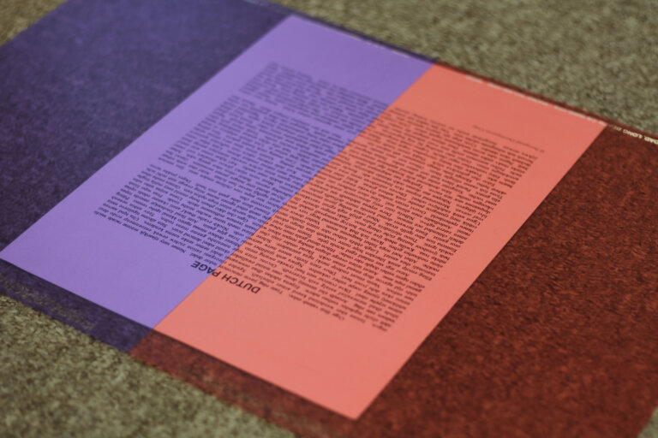
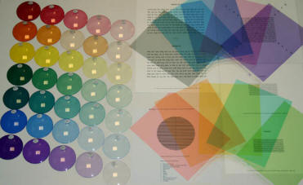
Research
The Neurodiversity Design System, which combines neurodiversity and user experience design for Learning Management Systems states that 'cognitive fatigue can be increased by high contrast (black text on white background)’.
‘Learners with an oversensitive visual cortex, visual-perceptual disorder, and learners with dyslexia related difficulties (Irlen Syndrome) will experience processing issues identified as part of their neurotype.'

Slide 9
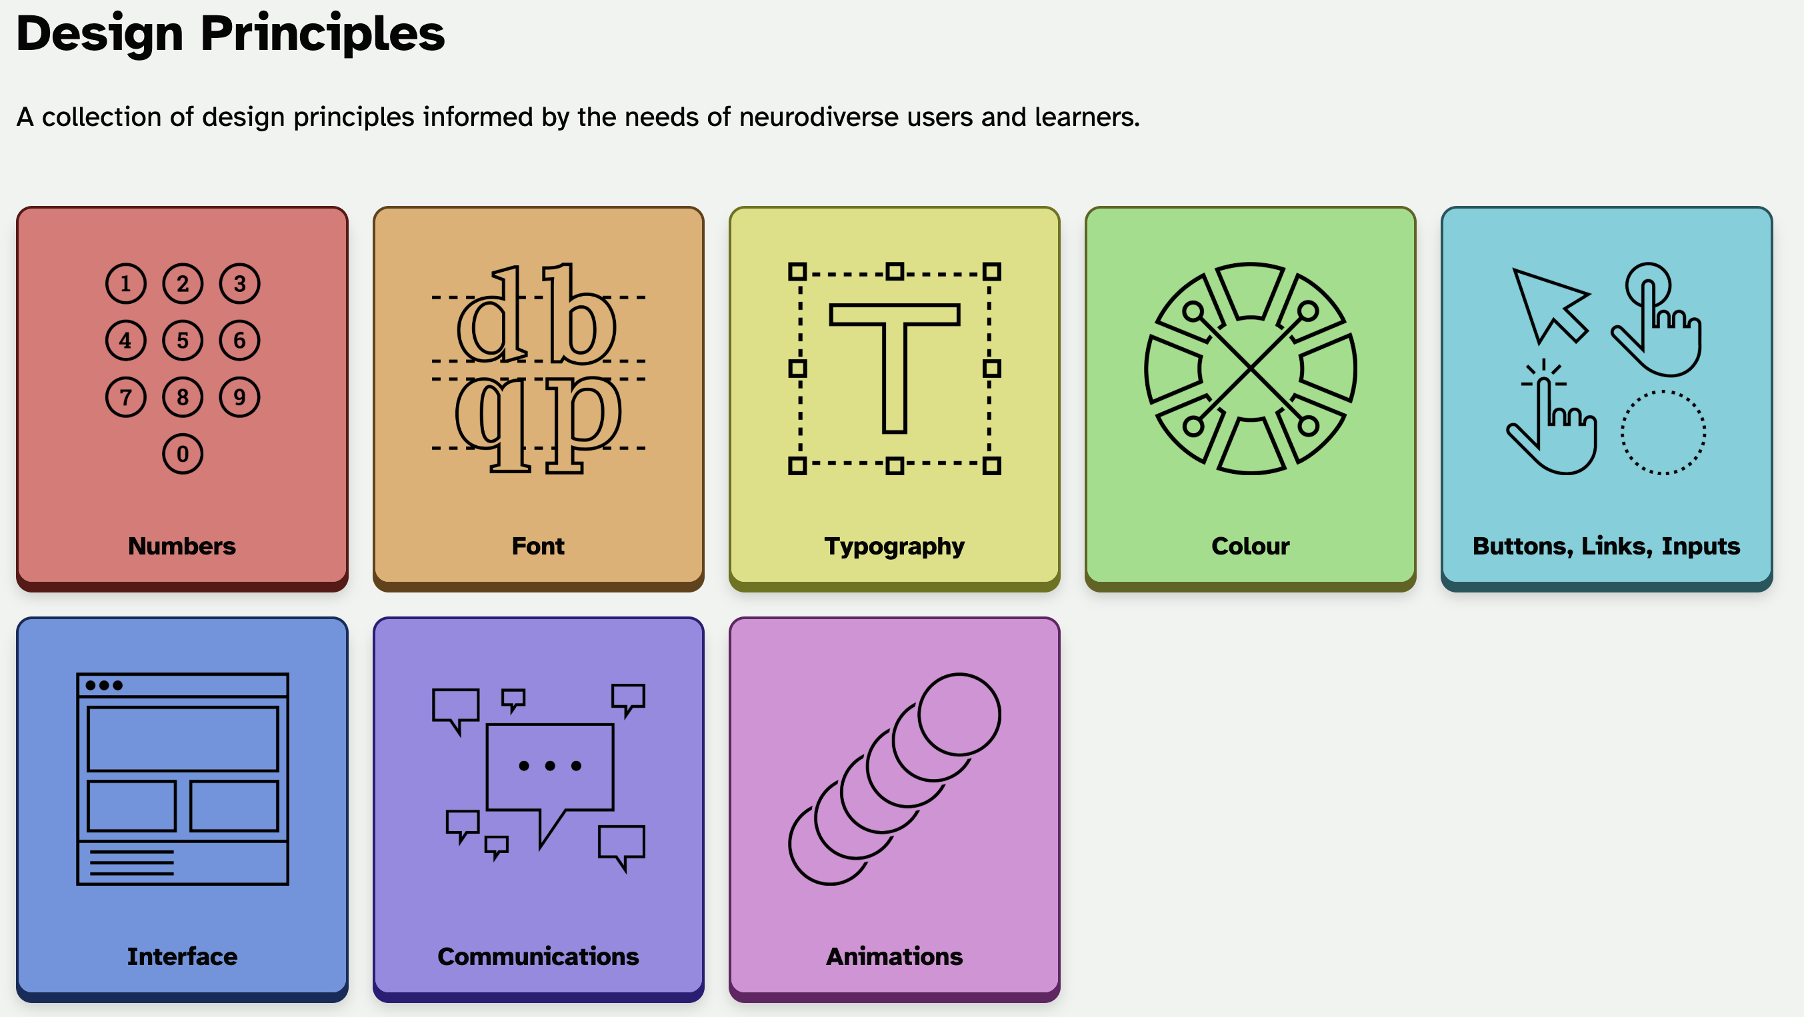

Slide 10
Research
According to the research, visual stress can be greatly reduced with the addition of colour, with the choice of colour for text maintaining a high contrast ratio with a coloured background eg. black text on a pastel colour background, or white text on a deeper coloured background.

Slide 11
Additional Benefits for Neurotypical Learners
It appears that there are benefits for neurotypical learners too, in reducing eyestrain when experiencing cognitive fatigue. Changing the visual appearance in this way has the potential to improve learning retention and ease anxiety related fatigue.

Slide 12
Testing
I have started to test this approach in my current lectures, in order to gain some feedback from the current cohort of first year students on the BSc Fashion Management course at LCF. It would be very easy to implement more widely, and has the potential to generate positive impact across the student population.

Slide 13
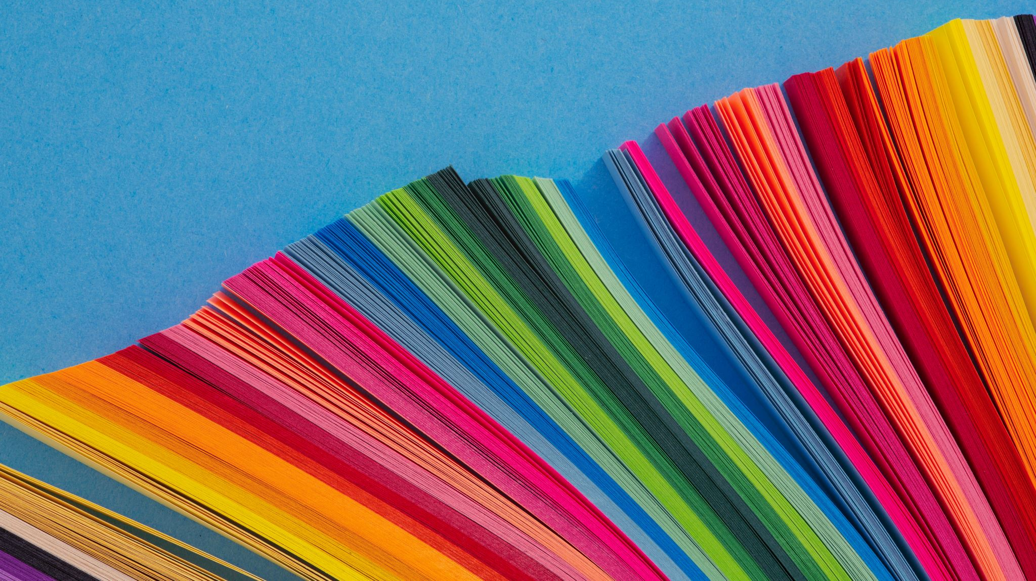
The Use of Colour in Learning Materials
The Use of Colour in Learning Materials
Unit Leader Julia Redman
BSc/MSc Fashion Management Block 2 04.03.2024

Slide 14
References
Wilkins, Arnold. J., Reading Through Colour: How coloured filters can reduce reading difficulty, eye strain and headaches (2003)
Neurodiversity Design System, Colour (22nd November 2023). Available at: https://neurodiversity.design/principles/colour/#:~:text=The%20choice%20of%20colour%20for,preferred%20for%20main%2F%20body%20text. (accessed 26.05.2025)
Helen Irlen, The Irlen Method https://irlen.com/the-irlen-method/ (accessed 26.05.2025)

Slide 15
Thank you
Julia Redman
Lecturer
j.k.redman@fashion.arts.ac.uk

